Slide 1
SE-3002 Software quality engineering Romasha khurshid Romasha.khurshid@nu.edu.pk
Quality types & quality cost
Overview and Basics
Lecture # 4,5,6

Slide 2
Today’s Outline
Types of Quality
QA VS QC
Cost of Quality
SQE activities
SQE activities and software processes
QIP
Effort profile
Notes:
https://classroom.google.com/u/1/c/Mjc1MTg1NDU1MDla

Slide 3
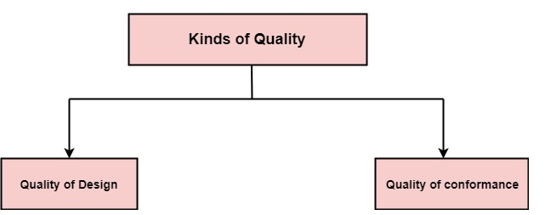
Kind of quality
Quality?
Two kinds of quality
Quality of design
Quality of Conformance

Slide 4
Quality of design
Quality of design is the degree to which the designers is intending to provide its customers.
Notes:
Related to requirements
https://www.chegg.com/homework-help/questions-and-answers/1discuss-detail-differences-quality-design-quality-conformance-impact-production-cost-also-q31556930

Slide 5
Quality of conformance
Quality of conformance is the degree to how well a product or service meets its specifications.
Notes:
Related to implementation

Slide 6
QC and QA
In order to maintain or enhance the quality of the offerings, manufacturers use two techniques, quality control and quality assurance.

Slide 7

Are qa and qc same terms?
BIG NO, these both terms are effectively different.
Most of the time we use both terms randomly, hence to study and understand the difference between them is important.

Slide 8
Are qa and qc same terms?
Lets differentiate according to the below points.
Definition
Focus on
Goal
How to achieve
Example
Responsibility

Slide 9
Definition of quality assurance and quality control
QA is the implementation of processes, methodologies and standards that ensure that the software developed will be up to the required quality standards.
QC is the set of activities that are carried out to verify the developed product meets the required standards.

Slide 10
Qa and QC focuses on
QA focuses on the improvement of process and methodologies used to develop product.
QC focuses on the improvement of the product by identifying the bugs and issues.

Slide 11
Goal of qa and QC:
The goal of QA is to improve development and test processes so that defects do not arise when the product is being developed. | The goal of QC is to identify defects after a product is developed and before it's released.

Slide 12
Nature of process
QA is preventive process as it establishes the methods which prevent the bugs.
QC is corrective process as it focuses on identifying the bugs and getting them fixed.

Slide 13
Verification vs Validation
Quality Assurance is a verification activity that verifies you are doing the right thing in the right manner.
Quality assurances is a validation activity that validates the product against the requirements.

Slide 14
Who
All the persons involved in the project starting from the requirement.
It is the responsibility of Quality Control inspector or the testing team that finds the issues.

Slide 15
Examples
Examples of quality assurance activities include process checklists, process standards, process documentation and project audit.
Examples of quality control activities include inspection, deliverable peer reviews and the software testing process.

Slide 16
Defects in the context of QA and quality engineering
Three generic ways to deal with defects include:
defect prevention
defect detection and removal
defect containment
Quality engineering can also be viewed as defect management. In addition to the execution of the planned QA activities, quality engineering also includes:
quality planning before specific QA activities are carried out
measurement, analysis, and feedback to monitor and control the QA activities
Notes:
Defect containment is about minimizing the defects that escape to downstream software development activities and making measurements of defects that are detected and escape.

Slide 17
COST of Quality(CoQ)

Slide 18
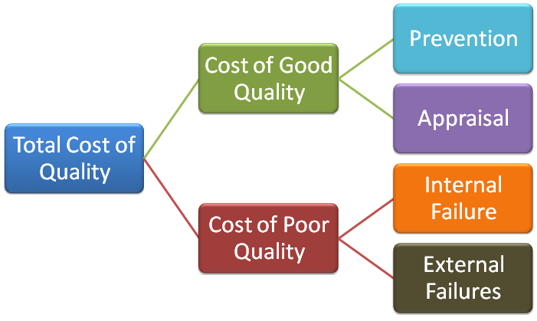
The classic model of “cost of software quality”
The classic quality cost model, developed in the early 1950s by Feigenbaum.
provides a methodology for classifying the costs associated with product quality.
The model classifies costs related to product quality into two general classes:

Slide 19
Cost of Software Quality (CoSQ)
Prevention Cost – costs associated with activities specifically designed to prevent poor quality in products.
Appraisal Cost – costs associated with activities specifically designed to measure, inspect, evaluate or audit products to assure conformance to quality requirements.
Internal Failure Cost – costs incurred when a product fails to conform to a quality specification before shipment to a customer.
External Failure Cost – costs incurred when a product fails to conform to a quality specification after shipment to a customer.

Slide 20
Prevention Activities:
Design Prevention:
Market Research
Design Review meetings
Design Verification And Validation
Prototyping Testing
Operation Prevention:
New Employee Screening
New Employee training and education

Slide 21
Prevention costs
Control of the SQA system through performance of:
Internal quality reviews

Slide 22
Appraisal Cost:
Appraisal costs are associated with any activity specifically designed to measure, inspect, evaluate or audit products to assure conformance to quality requirements.

Slide 23
Appraisal costs:
Reviews
Costs of software testing
Costs of assuring quality of external participants, primarily by means of design reviews and software testing. These activities are applied to the activities performed by:
Subcontractors
Suppliers of COTS software systems and reusable software modules
The customer as a participant in performing the project.

Slide 24
The classic model of cost of software quality
Internal failure costs include costs of correcting errors that have been detected by design reviews, software tests and acceptance tests (carried out by the customer) and completed before the software is installed at customer sites.
External failure costs include all costs of correcting failures detected by customers or the maintenance team after the software system has been installed

Slide 25
The classic model of cost of software quality
Internal failure costs
internal failure costs represent the costs of error correction subsequent to formal examinations of the software during its development, prior to the system’s installation at the customer’s site.
Costs of redesign or design corrections subsequent to design review and test findings
Costs of re-programming or correcting programs in response to test findings
Employee Turnover

Slide 26
The classic model of cost of software quality
External failure costs
External failure costs entail the costs of correcting failures detected by customers or maintenance teams after the software system has been installed at customer sites.
These costs may be further classified into “overt” external failure costs and “hidden” external failure costs. In most cases, the extent of hidden costs is much greater than that of overt costs. Typical overt external failure costs include:
Resolution of customer complaints during the warranty period
Correction of software bugs detected during regular operation (often performed at customer’s site)
Loss of reputation or goodwill
Product recalls and market actions.

Slide 27
The classic model of cost of software quality
Typical examples of hidden external failure costs are:
Damages of reduction of sales to customers suffering from high rates of software failures

Slide 28
An extended model for cost of software quality
The extended cost of software quality model, extends the classic model to include management’s “contributions”

Slide 29
An extended model for cost of software quality
Managerial preparation and control costs
Costs of carrying out contract reviews (proposal draft and contract draft reviews).
Costs of preparing project plans, including quality plans and their review.
Costs of periodic updating of project and quality plans.
Costs of performing regular progress control of internal software development efforts.

Slide 30
An extended model for cost of software quality
Managerial failure costs
Underestimation of the resources
The unrealistic schedule presented in the company’s proposal.
Domino effect: damages to other projects performed by the same teams involved in the delayed projects. whose scheduling problems interfered with the progress of other projects.

Slide 31
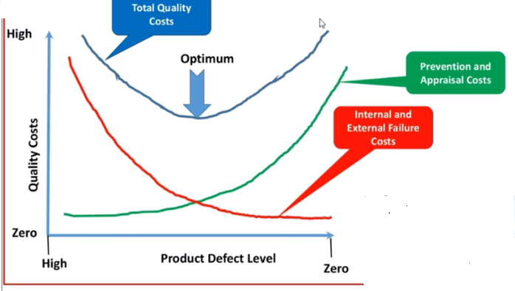
Relation between different quality cost

Slide 32
Quality Engineering
Different customers and users have different quality expectations under different market environments. Therefore, we need to move beyond just performing QA activities toward quality engineering by managing these quality expectations as an engineering problem.

Slide 33
Software Quality Engineering
The application of a continuous, systematic, disciplined, quantifiable approach to the development and maintenance of quality throughout the whole life cycle of software products and systems; that is, the application of quality engineering to software,
The study of approaches as in (1).

Slide 34
Quality Engineering: Activities and Process
There are three major groups of activities in the quality engineering process:
pre-QA activities, in-QA activities, and post-QA activities

Slide 35
Quality Engineering: Activities and Process
Pre-QA activities:
Quality planning
These are the activities that should be carried out before carrying out the regular QA activities. There are two major types of pre-QA activities in quality planning, including:
Set specific quality goals.
Form an overall QA strategy, which includes two sub-activities:
Select appropriate QA activities to perform.
Choose appropriate quality measurements and models
Notes:
quality goals are set on different quality views and attributes

Slide 36
Quality Engineering: Activities and Process
In-QA activities:
Executing planned QA activities and handling discovered defects
In addition to performing selected QA activities, an important part of this normal execution is to deal with the discovered problems.

Slide 37
Quality Engineering: Activities and Process
Post-QA activities:
Quality measurement, assessment and improvement
The primary purpose of these activities is to provide quality assessment and feedback so that various management decisions can be made and possible quality improvement initiatives can be carried out
Short-term feedback
provides information for progress tracking, activity scheduling, and identification of areas that need special attentions
Long-term feedback
Feedback to quality planning so that necessary adjustment can be made to quality goals and QA strategies
Feedback to the quality assessment and improvement activities

Slide 38
Quality Engineering and Quality Improvement Paradigm (QIP)
The Quality Improvement Paradigm (QIP) suggests the following activities to achieve quality improvement
measurement, analysis, feedback, and organizational support
QIP includes three interconnected steps: understanding, assessing, and packaging
The first step is to understand the baseline
The second step is to introduce process changes through experiments, pilot projects, assess their impact.
The last step is to package baseline data, experiment results, local experience, and updated process.

Slide 39
Quality Engineering in Software Process
The quality engineering process forms an integral part of the overall software engineering process, where other concerns, such as cost and schedule, are also considered and managed.
Individual QA activities can be carried out and integrated into the software process. When we broaden our scope to quality engineering, it also covers pre-QA quality planning as well as the post-QA measurement and analysis activities carried out parallel to and after QA activities to provide feedback and other useful information.
All these activities and the quality engineering process can be integrated into the overall software process.

Slide 40
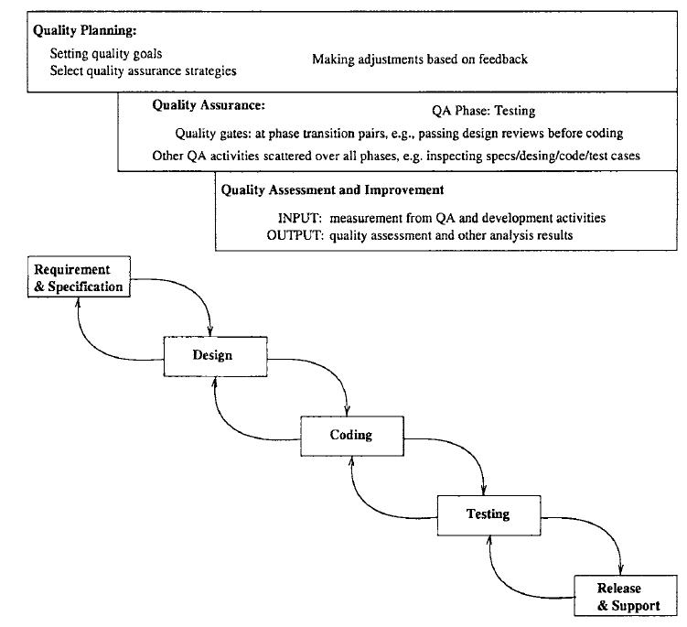
Quality Engineering in the Waterfall Process

Slide 41
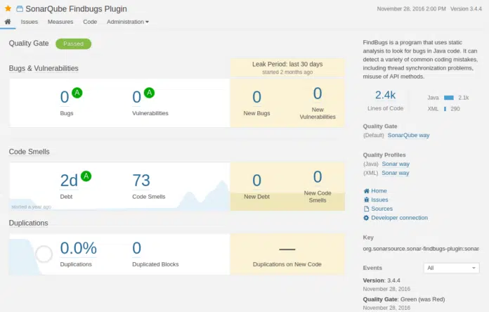
Tool For Static Analysis:

Slide 42
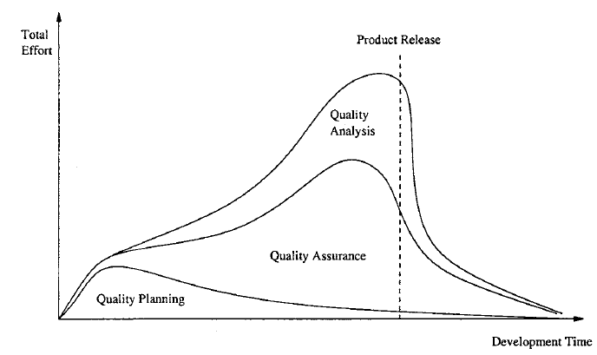
Effort Profile
The exact profile based on real data would not be as smooth and would naturally show large amount of variability, with many small peaks and valleys. But the general shape and pattern should preserve.

Slide 43
Effort Profile
Waterfall process would see more dominance of quality planning in the beginning.
Other development processes, such as incremental, iterative, spiral, and extreme programming processes, would be associated with curves that vary less between the peaks and valleys. QA is spread out more evenly in these processes than in the waterfall process, although it is still expected to peak a little bit before product release.

Slide 44
Concluding Remarks
To manage the quality assurance (QA) activities and to provide realistic opportunities of quantifiable quality improvement, we need to go beyond QA to perform the following:
Quality planning before specific QA activities are carried out, in the pre-QA activities in software quality engineering
Need to set the overall quality goal by managing customer’s quality expectations under the project cost and budgetary constraints
Quality quantification and improvement through measurement, analysis, feedback, and follow-up activities.
These activities need to be carried out after the start of specific QA activities, in the so-called post-QA activities in software quality engineering

Slide 45
SQA Tasks, Goals, Attributes, and Metrics
Software quality assurance (SQA) is a process which assures that all software engineering processes, methods, activities and work items are monitored and comply against the defined standards. These defined standards could be one or a combination of any like ISO 9000, CMMI model, ISO15504, etc.
SQA incorporates all software development processes starting from defining requirements to coding until release. Its prime goal is to ensure quality.

Slide 46
SQA goals
Requirement quality : The correctness, completeness, and consistency of the requirements model will have a strong influence on the quality of all work products that follow. SQA must ensure that the software team has properly reviewed the requirements model to achieve a high level of quality.
Design quality : Every element of the design model should be assessed by the software team to ensure that it exhibits high quality and that the design itself conforms to requirements.

Slide 47
SQA goals
Code quality : Source code and related work products must conform to local coding standards and exhibit characteristics that will facilitate maintainability.
Quality control effectiveness : A software team should apply limited resources in a way that has the highest likelihood of achieving a high–quality result. SQA analyzes the allocation of resources for reviews and testing to assess whether they are being allocated in the most effective manner.

Slide 48
Software quality goals, attributes, and metrics
Goal | Attribute | Metric
Requirement quality | Ambiguitly | Number of ambiguous modifiers
 | Understandability | Number of sections/subsections
 | Volatility | Number of changes per requirement Time (by activity) when change is requested
 | Traceability | Number of requirements not traceable to design/code
 | Model clarity | Number of UML models Number of descriptive pages per model Number of UML errors

Slide 49
Software quality goals, attributes, and metrics
Design quality | Architectural integrity Component completeness Interface complexity Patterns | Existence of architectural model Number of components that trace to architectural model Complexity of procedural design Average number of pick to get to a typical function or content Layout appropriateness Number of patterns used

Slide 50
Software quality goals, attributes, and metrics
Code quality | Complexity Maintainability Understandability Reusability Documentation | Cyclomatic complexity Design factors Percent internal comments Variable naming conventions Percent reused components Readability index

Slide 51
Software quality goals, attributes, and metrics
QC effectiveness | Resource allocation Completion rate Testing effectiveness | Staff hour percentage per activity Actual vs. budgeted completion time Number of errors found and criticality Effort required to correct an error Origin of error

Slide 52

That is all

